Slide 2
Topics
The if Statement
The if-else Statement
Comparing Strings
Nested Decision Structures and the if-elif-else Statement
Logical Operators
Boolean Variables
Turtle Graphics: Determining the State of the Turtle

Slide 3
The if Statement
Control structure: logical design that controls order in which set of statements execute
Sequence structure: set of statements that execute in the order they appear
Decision structure: specific action(s) performed only if a condition exists
  Also known as selection structure

Slide 4
The if Statement (cont’d.)
In flowchart, diamond represents true/false condition that must be tested
Actions can be conditionally executed
  Performed only when a condition is true
Single alternative decision structure: provides only one alternative path of execution
  If condition is not true, exit the structure

Slide 5
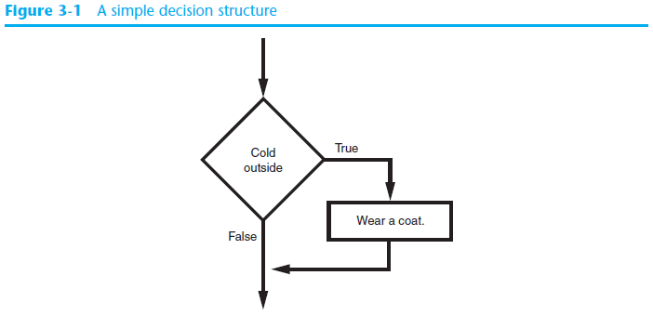
The if Statement (cont’d.)

Slide 6
The if Statement (cont’d.)
Python syntax:
  if condition:
    Statement
    Statement
First line known as the if clause
  Includes the keyword if followed by condition
    The condition can be true or false
    When the if statement executes, the condition is tested, and if it is true the block statements are executed. otherwise, block statements are skipped

Slide 7
Indentation
Increase indent indent after an if statement or for statement (after : )
Maintain indent to indicate the scope of the block (which lines are affected by the if/for)
Reduce indent back to the level of the if statement or for statement to indicate the end of the block
Blank lines are ignored - they do not affect indentation
Comments on a line by themselves are ignored with regard to indentation

Slide 8
Conditional Steps
x = 5
Program:
x = 5
if x < 10:
print('Smaller')
if x > 20:
print('Bigger')
print('Finis')
x < 10 ?
Yes
Output:
Smaller
Finis
No
print('Smaller')
x > 20 ?
Yes
No
print('Bigger')
print('Finis')

Slide 9
One-Way Decisions
x = 5
print('Before 5’)
if x == 5 :
print('Is 5')
print('Is Still 5')
print('Third 5’)
print('Afterwards 5')
print('Before 6’)
if x == 6 :
print('Is 6')
print('Is Still 6')
print('Third 6’)
print('Afterwards 6')
Before 5
Is 5
Is Still 5
Third 5
Afterwards 5
Before 6
Is 6
Is Still 6
Third 6
Afterwards 6
x == 5 ?
Yes
No
print('Is 5’)
print('Still 5')
print('Third 5')

Slide 10
increase / maintain after if or for
decrease to indicate end of block
x = 5
if x > 2 :
print('Bigger than 2')
print('Still bigger')
print('Done with 2')
for i in range(5) :
print(i)
if i > 2 :
print('Bigger than 2')
print('Done with i', i)
print('All Done')

Slide 11
Think About begin/end Blocks
x = 5
if x > 2 :
print('Bigger than 2')
print('Still bigger')
print('Done with 2')
for i in range(5) :
print(i)
if i > 2 :
print('Bigger than 2')
print('Done with i', i)
print('All Done')

Slide 12
Nested Decisions
x > 1
yes
x = 42
if x > 1 :
print('More than one')
if x < 100 :
print('Less than 100')
print('All done')
no
print('More than one’)
x < 100
yes
no
print('Less than 100')
print('All Done')

Slide 13
Boolean Values and Boolean Expressions
There are only two boolean values. They are True and False. Capitalization is important, since true and false are not boolean values (remember Python is case sensitive).

Slide 14
Boolean Values
Boolean values are not strings!
It is extremely important to realize that True and False are not strings. They are not surrounded by quotes. They are the only two values in the data type bool.
print(type(True))
print(type("True"))
print(5 == 5)
print(5 == 6)

Slide 15
Boolean Expressions and Relational Operators
Boolean expression: expression tested by if statement to determine if it is true or false
  Example: a > b
    true if a is greater than b; false otherwise
Relational operator: determines whether a specific relationship exists between two values
  Example: greater than (>)

Slide 16
Boolean Expressions and Relational Operators (cont’d.)
>= and <= operators test more than one relationship
  It is enough for one of the relationships to exist for the expression to be true
== operator determines whether the two operands are equal to one another
  Do not confuse with assignment operator (=)
!= operator determines whether the two operands are not equal

Slide 17
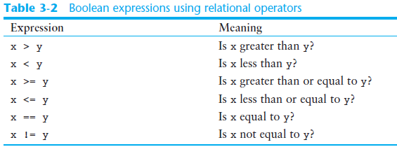
Boolean Expressions and Relational Operators (cont’d.)

Slide 18
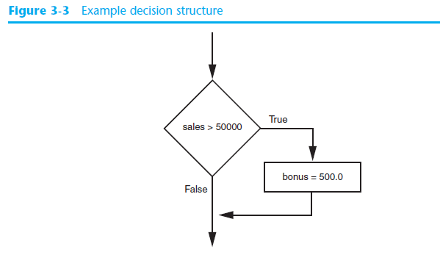
Boolean Expressions and Relational Operators (cont’d.)
Using a Boolean expression with the > relational operator
  if sales > 50000:
  bonus = 500.0

Slide 19
Boolean Expressions and Relational Operators (cont’d.)
high_score = 95
# Get the three test scores.
test1 = int(input('Enter the score for test 1: '))
test2 = int(input('Enter the score for test 2: '))
test3 = int(input('Enter the score for test 3: '))
average = (test1 + test2 + test3) / 3
print('The average score is', average)
if average >= high_score:
print('Congratulations!')
print('That is a great average!')

Slide 20
Boolean Expressions and Relational Operators (cont’d.)
Any relational operator can be used in a decision block
  Example: if balance == 0
  Example: if payment != balance
It is possible to have a block inside another block
  Example: if statement inside a function
  Statements in inner block must be indented with respect to the outer block

Slide 21
Comparison Operators
Boolean expressions ask a question and produce a Yes or No result which we use to control program flow
Boolean expressions using comparison operators evaluate to True / False or Yes / No
Comparison operators look at variables but do not change the variables
Python | Meaning
< | Less than
<= | Less than or Equal to
== | Equal to
>= | Greater than or Equal to
> | Greater than
!= | Not equal
http://en.wikipedia.org/wiki/George_Boole
Remember: “=” is used for assignment.

Slide 22
Comparison Operators
x = 5
if x == 5 :
print('Equals 5')
if x > 4 :
print('Greater than 4')
if x >= 5 :
print('Greater than or Equals 5')
if x < 6 : print('Less than 6')
if x <= 5 :
print('Less than or Equals 5')
if x != 6 :
print('Not equal 6')
Equals 5
Greater than 4
Greater than or Equals 5
Less than 6
Less than or Equals 5
Not equal 6

Slide 23
The if-else Statement
Dual alternative decision structure: two possible paths of execution
  One is taken if the condition is true, and the other if the condition is false
  Syntax: if condition:
    statements
    else:
    other statements
  if clause and else clause must be aligned
  Statements must be consistently indented

Slide 24
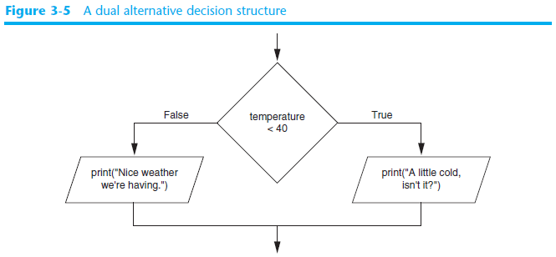
The if-else Statement (cont’d.)

Slide 25
The if-else Statement (cont’d.)
if temperature < 40:
  print (“A little cold, isn’t it?”)
  else:
  print (“Nice weather we’re having.”)

Slide 26
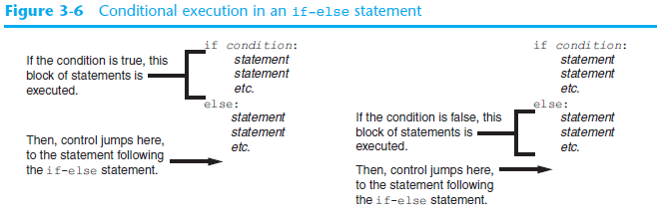
The if-else Statement (cont’d.)

Slide 27
The if-else Statement (cont’d.)
base_hours = 40 # Base hours per week
ot_multiplier = 1.5 # Overtime multiplier
# Get the hours worked and the hourly pay rate.
hours = float(input('Enter the number of hours worked: '))
pay_rate = float(input('Enter the hourly pay rate: '))
# Calculate and display the gross pay.
if hours > base_hours:
overtime_hours = hours - base_hours
overtime_pay = overtime_hours * pay_rate * ot_multiplier
gross_pay = base_hours * pay_rate + overtime_pay
else:
gross_pay = hours * pay_rate
print('The gross pay is $', format(gross_pay, ',.2f'), sep='')

Slide 28
Two-way Decisions
Sometimes we want to do one thing if a logical expression is true and something else if the expression is false
It is like a fork in the road - we must choose one or the other path but not both
x = 4
no
x > 2
yes
print(‘Smaller')
print('Bigger')
print('All done!')

Slide 29
Two-way Decisions with else:
x = 4
if x > 2 :
print('Bigger')
else :
print('Smaller')
print('All done!')
x = 4
no
x > 2
yes
print(‘Smaller')
print('Bigger')
print('All done!')

Slide 30
Visualize Blocks
x = 4
if x > 2 :
print('Bigger')
else :
print('Smaller')
print('All done!')
x = 4
no
x > 2
yes
print(‘Smaller')
print('Bigger')
print('All done!')

Slide 31
Comparing Strings
Strings can be compared using the == and != operators
String comparisons are case sensitive
Strings can be compared using >, <, >=, and <=
  Compared character by character based on the ASCII values for each character
  If shorter word is substring of longer word, longer word is greater than shorter word

Slide 32
Comparing Strings
# This program compares two strings.
# Get a password from the user.
password = input('Enter the password: ')
# Determine whether the correct password
# was entered.
if password == 'prospero':
print('Password accepted.')
else:
print('Sorry, that is the wrong password.')

Slide 33
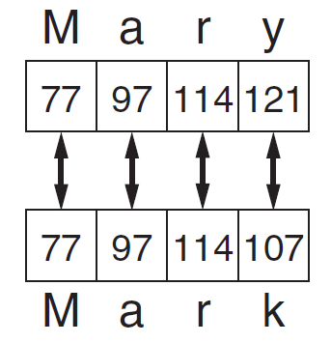
Comparing Strings (cont’d.)

Slide 34
Comparing Strings (cont’d.)
# This program compare strings with the < operator.
# Get two names from the user.
name1 = input('Enter a name (last name first): ')
name2 = input('Enter another name (last name first): ')
# Display the names in alphabetical order.
print('Here are the names, listed alphabetically.')
if name1 < name2:
print(name1)
print(name2)
else:
print(name2)
print(name1)

Slide 35
Nested Decision Structures and the if-elif-else Statement
A decision structure can be nested inside another decision structure
  Commonly needed in programs
  Example:
    Determine if someone qualifies for a loan, they must meet two conditions:
      Must earn at least $30,000/year
      Must have been employed for at least two years
    Check first condition, and if it is true, check second condition

Slide 36
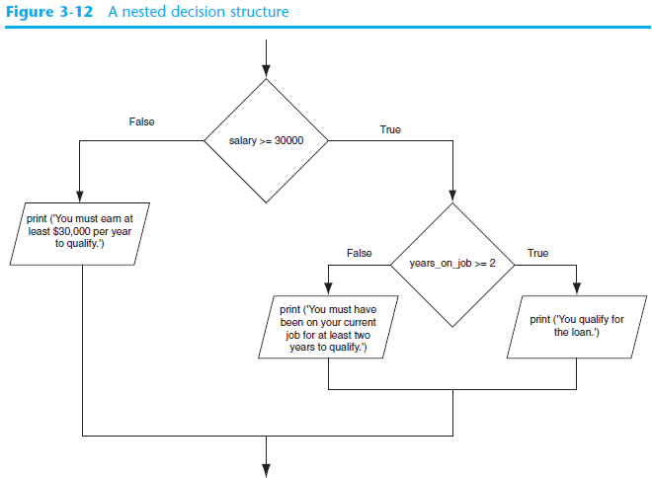

Slide 37
Nested Decision Structures and the if-elif-else Statement
# This program determines whether a bank customer
# qualifies for a loan.
min_salary = 30000.0 # The minimum annual salary
min_years = 2 # The minimum years on the job
# Get the customer's annual salary.
salary = float(input('Enter your annual salary: '))
# Get the number of years on the current job.
years_on_job = int(input('Enter the number of ' +
'years employed: '))

Slide 38
Nested Decision Structures and the if-elif-else Statement
# Determine whether the customer qualifies.
if salary >= min_salary:
if years_on_job >= min_years:
print('You qualify for the loan.')
else:
print('You must have been employed', \
'for at least', min_years, \
'years to qualify.')
else:
print('You must earn at least $', \
format(min_salary, ',.2f'), \
' per year to qualify.', sep='')

Slide 39
Nested Decision Structures and the if-elif-else Statement (cont’d.)
Important to use proper indentation in a nested decision structure
  Important for Python interpreter
  Makes code more readable for programmer
  Rules for writing nested if statements:
    else clause should align with matching if clause
    Statements in each block must be consistently indented

Slide 40
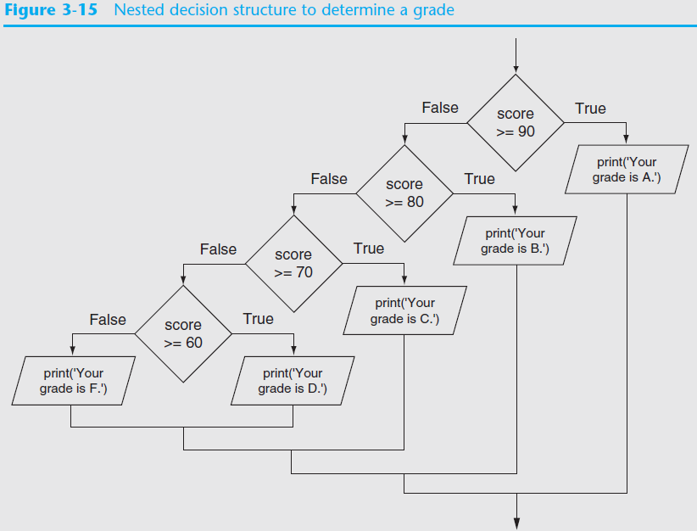

Slide 41
Nested Decision Structures and the if-elif-else Statement (cont’d.)
# This program gets a numeric test score from the
# user and displays the corresponding letter grade.
# Variables to represent the grade thresholds
A_score = 90
B_score = 80
C_score = 70
D_score = 60
# Get a test score from the user.
score = int(input('Enter your test score: '))

Slide 42
Nested Decision Structures and the if-elif-else Statement (cont’d.)
# Determine the grade.
if score >= A_score:
print('Your grade is A.')
else:
if score >= B_score:
print('Your grade is B.')
else:
if score >= C_score:
print('Your grade is C.')
else:
if score >= D_score:
print('Your grade is D.')
else:
print('Your grade is F.')

Slide 43
The if-elif-else Statement
if-elif-else statement: special version of a decision structure
  Makes logic of nested decision structures simpler to write
    Can include multiple elif statements
  Syntax:
if condition_1:
statement(s)
elif condition_2:
statement(s)
elif condition_3:
statement(s)
else
statement(s)
Insert as many elif clauses
as necessary.

Slide 44
The if-elif-else Statement (cont’d.)
Alignment used with if-elif-else statement:
  if, elif, and else clauses are all aligned
  Conditionally executed blocks are consistently indented
if-elif-else statement is never required, but logic easier to follow
  Can be accomplished by nested if-else
    Code can become complex, and indentation can cause problematic long lines

Slide 45
The if-elif-else Statement
if score >= A_score:
print('Your grade is A.')
elif score >= B_score:
print('Your grade is B.')
elif score >= C_score:
print('Your grade is C.')
elif score >= D_score:
print('Your grade is D.')
else:
print('Your grade is F.')

Slide 46
Multi-way
if x < 2 :
print('small')
elif x < 10 :
print('Medium')
else :
print('LARGE')
print('All done!')
yes
x < 2
print('small')
no
yes
x < 10
print('Medium')
no
print('LARGE')
print('All done!')

Slide 47
Multi-way
x = 0
x = 0
if x < 2 :
print('small')
elif x < 10 :
print('Medium')
else :
print('LARGE')
print('All done!')
yes
x < 2
print('small')
no
yes
x < 10
print('Medium')
no
print('LARGE')
print('All done!')

Slide 48
Multi-way
x = 5
x = 5
if x < 2 :
print('small')
elif x < 10 :
print('Medium')
else :
print('LARGE')
print('All done!')
yes
x < 2
print('small')
no
yes
x < 10
print('Medium')
no
print('LARGE')
print('All done!')

Slide 49
Multi-way
x = 20
x = 20
if x < 2 :
print('small')
elif x < 10 :
print('Medium')
else :
print('LARGE')
print('All done!')
yes
x < 2
print('small')
no
yes
x < 10
print('Medium')
no
print('LARGE')
print('All done!')

Slide 50
Multi-way
if x < 2 :
print('Small')
elif x < 10 :
print('Medium')
elif x < 20 :
print('Big')
elif x < 40 :
print('Large')
elif x < 100:
print('Huge')
else :
print('Ginormous')
# No Else
x = 5
if x < 2 :
print('Small')
elif x < 10 :
print('Medium')
print('All done!')

Slide 51
Multi-way Puzzles
Which will never print regardless of the value for x?
if x < 2 :
print('Below 2')
elif x >= 2 :
print('Two or more')
else :
print('Something else')
if x < 2 :
print('Below 2')
elif x < 20 :
print('Below 20')
elif x < 10 :
print('Below 10')
else :
print('Something else')

Slide 52
Logical Operators
Logical operators: operators that can be used to create complex Boolean expressions
  and operator and or operator: binary operators, connect two Boolean expressions into a compound Boolean expression
  not operator: unary operator, reverses the truth of its Boolean operand

Slide 53
The and Operator
Takes two Boolean expressions as operands
  Creates compound Boolean expression that is true only when both sub expressions are true
  Can be used to simplify nested decision structures
Truth table for
the and operator
Expression | Value of the Expression
false and false | false
false and true | false
true and false | false
true and true | true

Slide 54
The or Operator
Takes two Boolean expressions as operands
  Creates compound Boolean expression that is true when either of the sub expressions is true
  Can be used to simplify nested decision structures
Truth table for
the or operator
Expression | Value of the Expression
false and false | false
false and true | true
true and false | true
true and true | true

Slide 55
Short-Circuit Evaluation
Short circuit evaluation: deciding the value of a compound Boolean expression after evaluating only one sub expression
  Performed by the or and and operators
    For or operator: If left operand is true, compound expression is true. Otherwise, evaluate right operand
    For and operator: If left operand is false, compound expression is false. Otherwise, evaluate right operand

Slide 56
The not Operator
Takes one Boolean expressions as operand and reverses its logical value
  Sometimes it may be necessary to place parentheses around an expression to clarify to what you are applying the not operator
Truth table for the not operator
Expression | Value of the Expression
true | false
false | true

Slide 57

Checking Numeric Ranges with Logical Operators
To determine whether a numeric value is within a specific range of values, use and
  Example: x >= 10 and x <= 20
To determine whether a numeric value is outside of a specific range of values, use or
  Example: x < 10 or x > 20

Slide 58
Loan Qualifier1
min_salary = 30000.0 # The minimum annual salary
min_years = 2 # The minimum years on the job
salary = float(input('Enter your annual salary: '))
years_on_job = int(input('Enter the number of ' +
'years employed: '))
if salary >= min_salary and years_on_job >= min_years:
print('You qualify for the loan.')
else:
print('You do not qualify for this loan.')

Slide 59
Loan Qualifier2
min_salary = 30000.0 # The minimum annual salary
min_years = 2 # The minimum years on the job
salary = float(input('Enter your annual salary: '))
years_on_job = int(input('Enter the number of ' +
'years employed: ‘))
if salary >= min_salary or years_on_job >= min_years:
print('You qualify for the loan.')
else:
print('You do not qualify for this loan.')

Slide 60
Boolean Variables
Boolean variable: references one of two values, True or False
  Represented by bool data type
Commonly used as flags
  Flag: variable that signals when some condition exists in a program
    Flag set to False → condition does not exist
    Flag set to True → condition exists

Slide 61
Boolean Variables
if sales>=50000.0:
sales_quota_met = True
else:
sales_quota_met = False
if sales_quota_met:
print (‘you have met your sales quota!’)

Slide 62
The try / except Structure
You surround a dangerous section of code with try and except
If the code in the try works - the except is skipped
If the code in the try fails - it jumps to the except section

Slide 63
$ python3 notry.py
Traceback (most recent call last): File "notry.py", line 2, in <module> istr = int(astr)ValueError: invalid literal for int() with base 10: 'Hello Cihan!'
$ cat notry.py
astr = 'Hello Cihan!'
istr = int(astr)
print('First:', istr)
astr = '123'
istr = int(astr)
print('Second:', istr)
All
Done

Slide 64
$ python3 notry.py
Traceback (most recent call last): File "notry.py", line 2, in <module> istr = int(astr)ValueError: invalid literal for int() with base 10: 'Hello Cihan!'
$ cat notry.py
astr = 'Hello Cihan!'
istr = int(astr)
print('First', istr)
astr = '123'
istr = int(astr)
print('Second', istr)
All
Done
The program stops here

Slide 65
Generic
Computer
Software
Input
Devices
Central
Processing
Unit
Secondary
Memory
Output
Devices
Main
Memory
Notes:
Who has see a traceback in CTools?

Slide 66
Generic
Computer
Software
Input
Devices
Central
Processing
Unit
Secondary
Memory
Output
Devices
Main
Memory
Notes:
Who has see a traceback in CTools?

Slide 67
When the first conversion fails - it just drops into the except: clause and the program continues.
astr = 'Hello Cihan!'
try:
istr = int(astr)
except:
istr = -1
print('First:’, istr)
astr = '123'
try:
istr = int(astr)
except:
istr = -1
print('Second:’, istr)
$ python tryexcept.py
First: -1
Second: 123
When the second conversion succeeds - it just skips the except: clause and the program continues.

Slide 68
try / except
astr = ‘Cihan'
try:
print('Hello')
istr = int(astr)
print('There')
except:
istr = -1
print('Done', istr)
astr = ‘Cihan'
print('Hello')
istr = int(astr)
print('There')
istr = -1
print('Done', istr)
Safety net

Slide 69
Sample try / except
rawstr = input('Enter a number:')
try:
ival = int(rawstr)
except:
ival = -1
if ival > 0 :
print('Nice work')
else:
print('Not a number')
$ python3 trynum.py
Enter a number:42
Nice work
$ python3 trynum.py
Enter a number:forty-two
Not a number
$

Slide 70
Turtle Graphics: Determining the State of the Turtle
The turtle.xcor() and turtle.ycor() functions return the turtle's X and Y coordinates
Examples of calling these functions in an if statement:
if turtle.ycor() < 0:
turtle.goto(0, 0)
if turtle.xcor() > 100 and turtle.xcor() < 200:
turtle.goto(0, 0)

Slide 71
Turtle Graphics: Determining the State of the Turtle
The turtle.heading() function returns the turtle's heading. (By default, the heading is returned in degrees.)
Example of calling the function in an if statement:
if turtle.heading() >= 90 and turtle.heading() <= 270:
turtle.setheading(180)

Slide 72
Turtle Graphics: Determining the State of the Turtle
The turtle.isdown() function returns True if the pen is down, or False otherwise.
Example of calling the function in an if statement:
if turtle.isdown():
turtle.penup()
if not(turtle.isdown()):
turtle.pendown()

Slide 73
Turtle Graphics: Determining the State of the Turtle
The turtle.isvisible() function returns True if the turtle is visible, or False otherwise.
Example of calling the function in an if statement:
if turtle.isvisible():
turtle.hideturtle()

Slide 74
Turtle Graphics: Determining the State of the Turtle
When you call turtle.pencolor() without passing an argument, the function returns the pen's current color as a string. Example of calling the function in an if statement:
When you call turtle.fillcolor() without passing an argument, the function returns the current fill color as a string. Example of calling the function in an if statement:
if turtle.pencolor() == 'red':
turtle.pencolor('blue')
if turtle.fillcolor() == 'blue':
turtle.fillcolor('white')

Slide 75
Turtle Graphics: Determining the State of the Turtle
When you call turtle.bgcolor() without passing an argument, the function returns the current background color as a string. Example of calling the function in an if statement:
if turtle.bgcolor() == 'white':
turtle.bgcolor('gray')

Slide 76
Turtle Graphics: Determining the State of the Turtle
When you call turtle.pensize() without passing an argument, the function returns the pen's current size as a string. Example of calling the function in an if statement:
if turtle.pensize() < 3:
turtle.pensize(3)

Slide 77
Turtle Graphics: Determining the State of the Turtle
When you call turtle.speed() without passing an argument, the function returns the current animation speed. Example of calling the function in an if statement:
if turtle.speed() > 0:
turtle.speed(0)

Slide 78
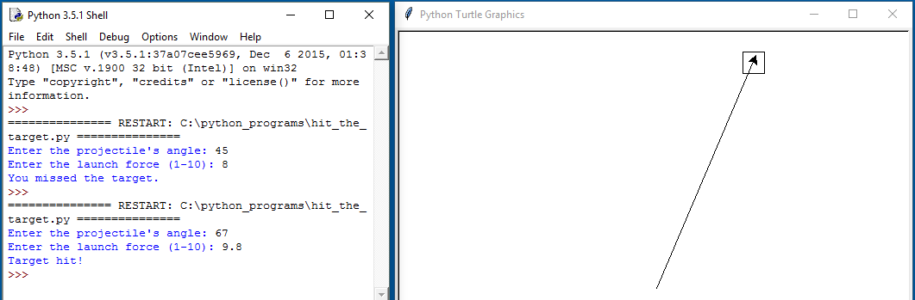
Turtle Graphics: Determining the State of the Turtle
See In the Spotlight: The Hit the Target Game in your textbook for numerous examples of determining the state of the turtle.

Slide 79
Summary
This chapter covered:
  Decision structures, including:
    Single alternative decision structures
    Dual alternative decision structures
    Nested decision structures
  Relational operators and logical operators as used in creating Boolean expressions
  String comparison as used in creating Boolean expressions
  Boolean variables and try / except to compensate for errors
  Determining the state of the turtle in Turtle Graphics

Slide 80


Acknowledgements / Contributions
These slides are Copyright 2010- Charles R. Severance (www.dr-chuck.com) of the University of Michigan School of Information and made available under a Creative Commons Attribution 4.0 License. Please maintain this last slide in all copies of the document to comply with the attribution requirements of the license. If you make a change, feel free to add your name and organization to the list of contributors on this page as you republish the materials.
Initial Development: Charles Severance, University of Michigan School of Information
… Insert new Contributors and Translators here
...

